Slide 1

The Fine Tuners
xx.12.2023
Presented by Shinu Joseph

Slide 2
Table of Content
01
Overview
Pre-requisites
Interface
02
Deployment Architecture
Extraction Phase
Transformation Phase
Load Phase
Final Dashboard
03
04
Challenges Faced
Workarounds
Model performance assurance
05
Summary

Slide 3

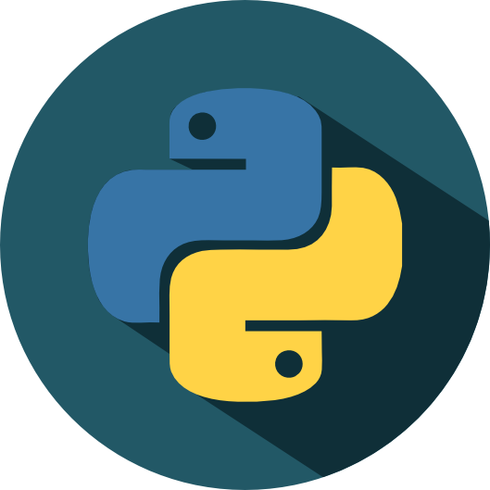




Overview
Objective : Orchestrate an end-to-end pipeline for the development and deployment of a sentiment detection model.
Solution aims to streamline the monitoring and assessment of maintenance activities within Thameslink to quickly identify areas of concern , leading to prompt response and continuous improvement while being scalable, secure and highly available for data storage.
Prerequisite Requirements
Interfaces
Twitter Account
Azure Student Subscription (free 100$ credit)
1
2
3
VS Code for build, integration and deployment
Notes:
Finish tmrw morning

Slide 4
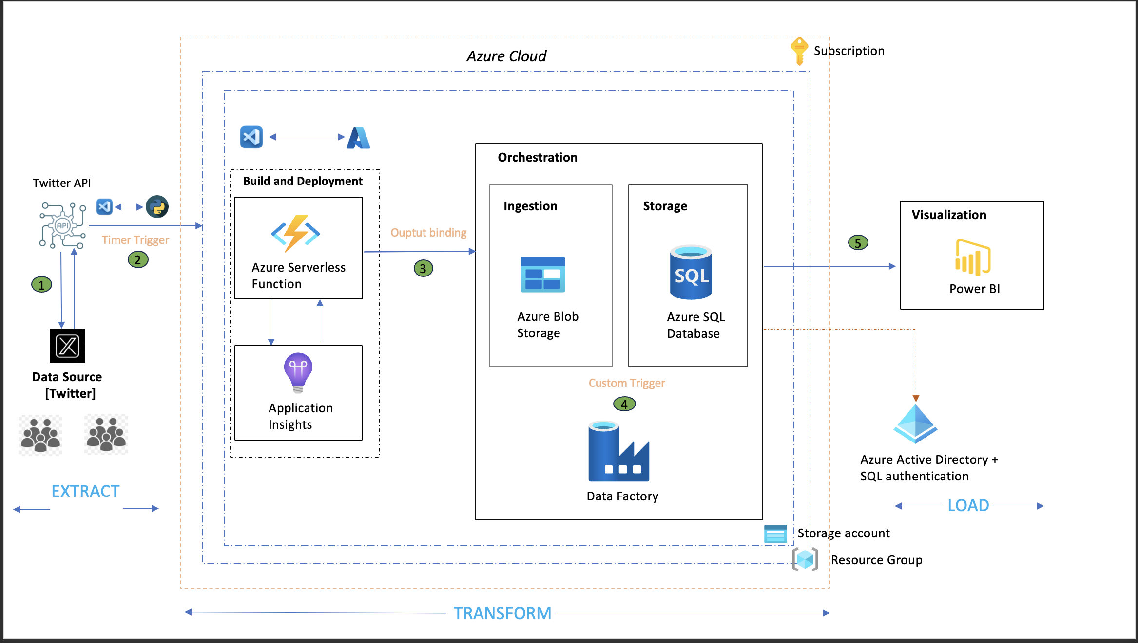
Architecture
Notes:
I would like to go back to business understanding

Slide 5
Extraction Phase
Go to the Twitter Developer website and login with the Twitter account.
Create a Twitter Application [ create a new project add an app to it ].
Generate the API key, API secret key, Access token, and Access token secret.
Connect to Twitter API using the Tweepy library in Python and the generated API keys and tokens.
Fetch tweets with specific keywords, once extracted proceed with the model building architecture in a modular format. [ main modules and submodules ]
Notes:
I would like to go back to business understanding

Slide 6
Transformation Phase – I (Build and Deploy)
Create a resource group and storage account under Azure subscription.
Integrate VScode and Azure Cloud to deploy Python code from local to cloud. Before deploying perform the below :
Create a function app : Azure Functions serverless compute service that enables you to run event-triggered code without explicitly provisioning or managing infrastructure.
Once function app is created, create a new function in Azure portal with timer trigger.
Timer Trigger : A type of trigger that helps to run a function on a specified schedule , similar to a cron job. Eg : "0 0 0 * * *" [ runs everyday at midnight ]
Create an output binding storage [defines the target destination or resource in a declarative manner within the function's configuration function.json file]. Here the output binding is Azure Blob Storage output of Azure function will be stored in blob container.
Notes:
Finish afternoon

Slide 7
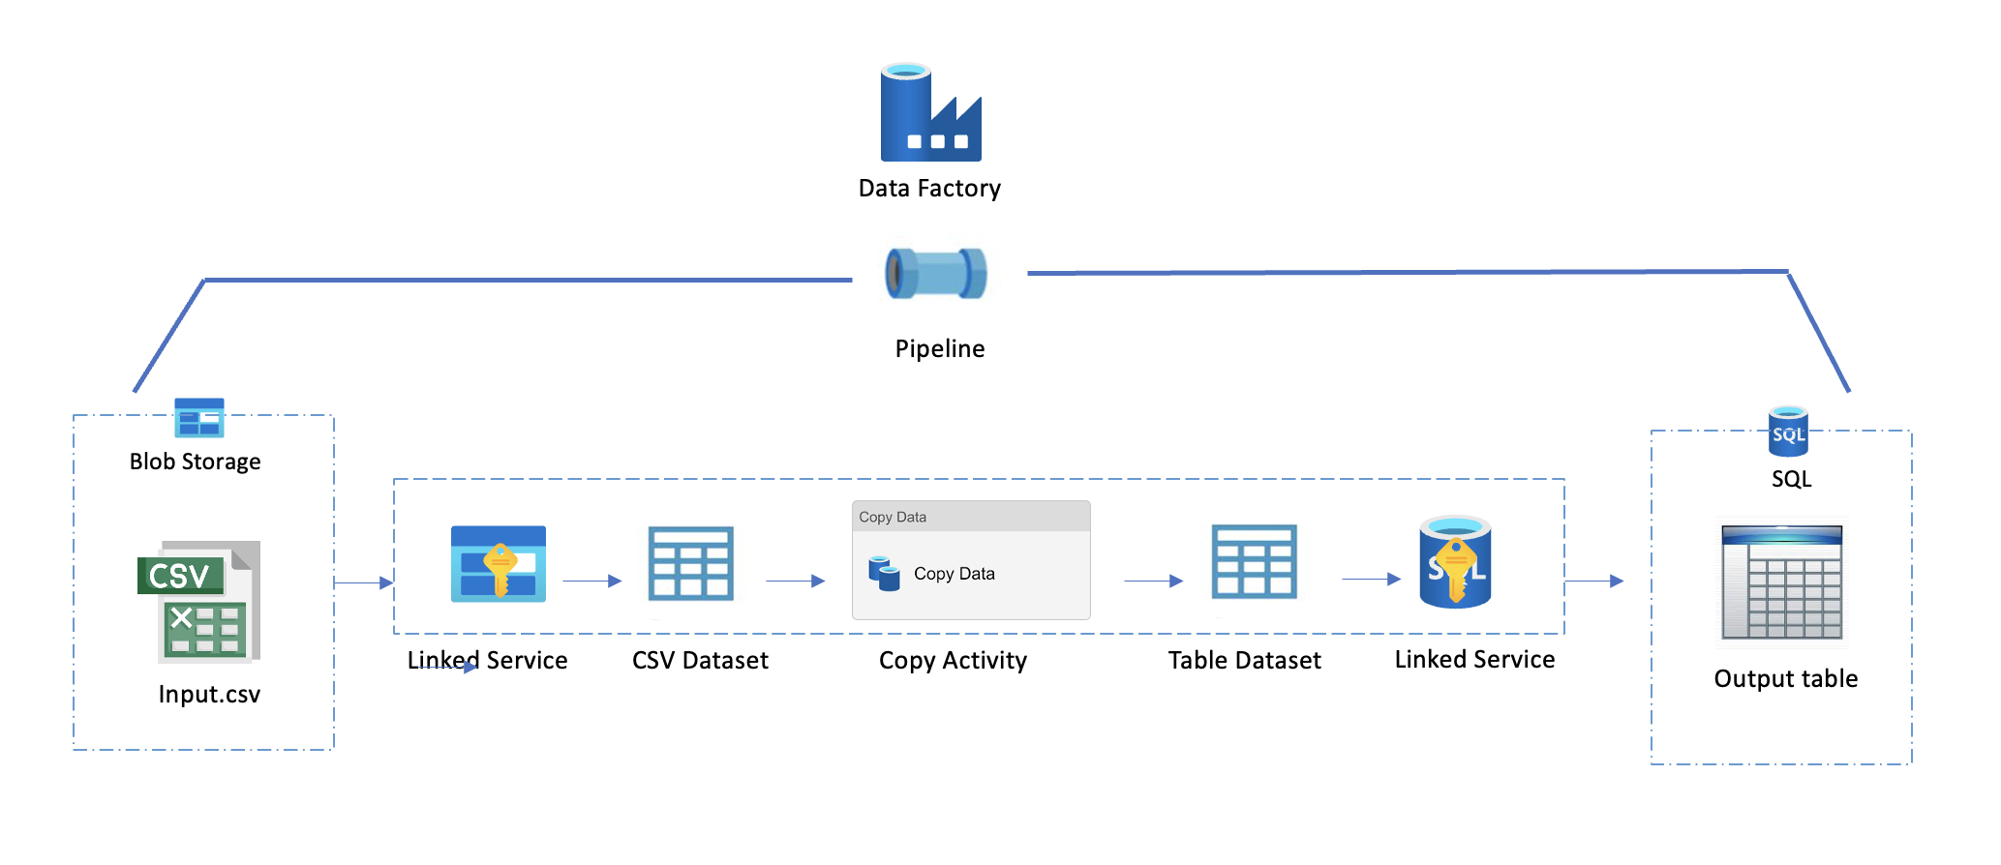
Transformation Phase – II (Orchestration)
Orchestration : Involves defining and managing pipelines and activities within the data integration and transformation processes.
ADF moves data from source (Blob) to sink (table) using copy as the data movement activity with custom trigger.
Notes:
Finish in the morning

Slide 8
Create an ADF intsance and connect it to a storage account.
Define source and sink.
Source : Azure blob storage (holds structured/semi-structured/unstructured data) currently holds csv files.
Sink : Azure SQL database (holds relational data)
Create linked services for source and sink.
Linked services store the connection information and credentials needed to connect to the data sources.
Create a pipeline in ADF and add “Copy Data Activity”. This helps to copy data from one data source to another.
Create datsets to define structure of the data and to also indicate how it should be consumed by activities in the pipeline.
Configure the source and sink datasets to point to source and sink providing necessary details. Map the source and sink schemas correctly.
Run the pipeline to execute the data copy operation. Monitor the progress, success, or any errors in the Azure Data Factory Monitoring interface.

Slide 9
Loading Phase
Interface : Azure SQL database (final storage) Power BI (for dashboard visualiation)
To establish connection, we require the below from Azure :
Server name (eg : <server_name>.database.windows.net)
Database name , username and password (required if using SQL server authentication).
Update Azure server firewall settings to include the IP of the machine trying to connect to SQL database.

Slide 10
Final Dashboard
INSERT DASHBORAD LINK HERE BITTE! :)

Slide 11
Challenges Faced
ODBC Driver compatibility issue : failed to establish a direct connection between the Azure Function App and SQL database.
Quick and efficient fix : Used Azure Data Factory to orchestrate data movement between source and sink with custom triggers.
Tweetnlp library (irony and sentiment analysis) encountering recognition issues within the Azure environment build failure.

Slide 12
Best Practices for Sustained High Performance of Deployed Models in Azure
Continuous Monitoring and Resource Scaling :
Monitoring tools like Azure Monitor and Azure Application Insights to track the deployment process in real-time.
Adjust the compute resources allocated to the deployed model based on changes in demand or data volume.
Logging and Auditing :
Ensure that the modular code has logging mechanisms to capture information for debugging and troubleshooting.
Model Retraining :
Schedule periodic retraining of the model using new and updated data to ensure model remains accurate and relevant to changes in data.
Data Drift Monitoring :
Monitor for data drift, which occurs when the distribution of incoming data changes over time using Azure Machine Learning Data Drift.
Documentation:
Maintain comprehensive documentation about the model, its deployment, and any updates or changes made over time.
Feedback loops :
Establish feedback loops to collect information about model predictions and their real-world outcomes.
Notes:
Finish tmrw morning

Slide 13
Summary
Defined the prerequisites and interfaces.
Elaborated the deployment architecture and the ETL pipeline.
Reviewed the dashboard.
Outlined challenges and best practices for model deployment sustenance.

Slide 14
THANK YOU !!!!!

